Slide 1
Power BI Embedded
FSI CSU SWARM

Slide 2
Hands-On Module

Slide 3
Power BI
Go to Power BI App (app.powerbi.com)

Slide 4
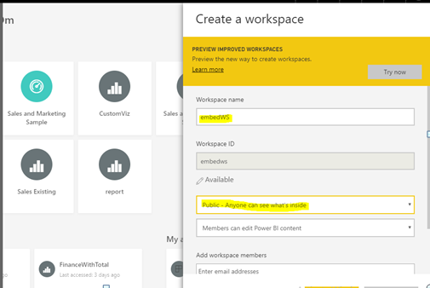
Power BI
Create Workspace
Note : Workspace name should match with application name we defined in azure portal.

Slide 5
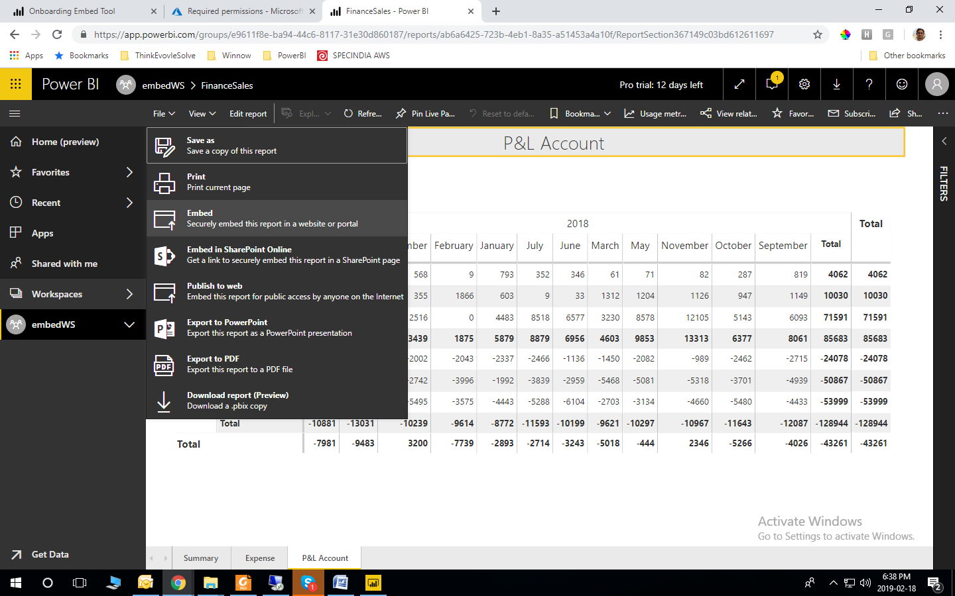
Power BI
Published the Power BI report in workspace we just created in above steps.
Open Power BI Report and click on File->Embed

Slide 6
Power BI
Copy the URL from the popup window.
Embed URL : https://app.powerbi.com/reportEmbed?reportId=ab6a6425-723b-4eb1-8a35-a51453a4a10f&groupId=e9611f8e-ba94-44c6-8117-31e30d860187
Report ID = ab6a6425-723b-4eb1-8a35-a51453a4a10f
Group ID = e9611f8e-ba94-44c6-8117-31e30d860187
Remember the values for
Embed URL
Group ID
Report ID

Slide 7
REST API
Call REST API to open Power BI report securely

Slide 8
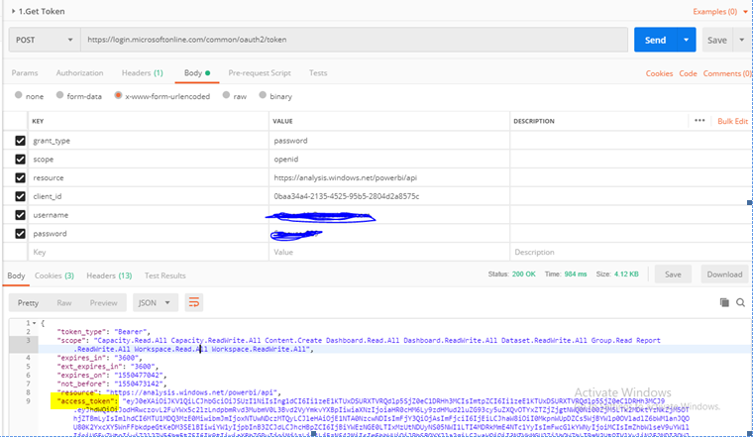
REST API
Call GetToken REST API with header and body
https://login.microsoftonline.com/common/oauth2/token
Header
Content-Type = application/x-www-form-urlencoded
Remember the values for Access Token from result

Slide 9
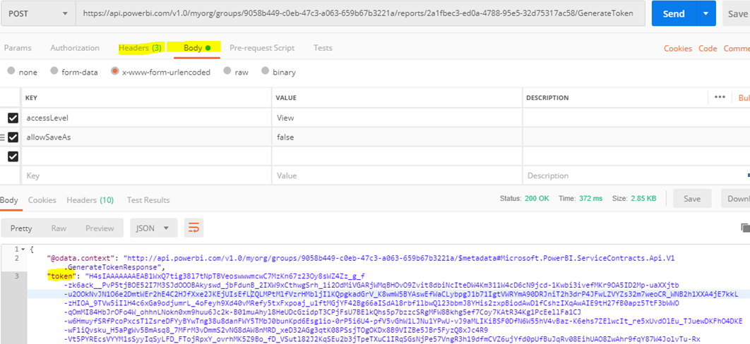
REST API
Generate embed token using below REST API
https://api.powerbi.com/v1.0/myorg/groups/<<GROUP ID>>/reports/<<REPORT ID>>/GenerateToken
Header
Authorization = Bearer <<Access Tocken>>
Content-Type = application/x-www-form-urlencoded
Accept=application/json
BODY
accessLevel = View
allowSaveAs=false
Remember Token from the result
Embed token

Slide 10
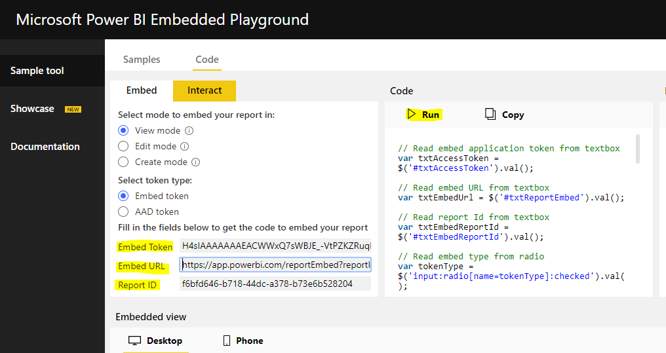
Attached Power BI Report in App
We have following items
Embed Token
Report ID
Group ID
Call Power BI Report using Microsoft Utilities
https://microsoft.github.io/PowerBI-JavaScript/demo/v2-demo/index.html

Slide 11
FAQs - Technical

Slide 12
FAQs
What are the prerequisites to create a PBIE capacity in Azure?
How do I manage permissions for service principals with Power BI?
Sign in to your organizational directory (MSA accounts are not supported).
You need to have a Power BI tenant, that is, at least one user in your directory has signed up to Power BI.
You need to have an Azure subscription in your organizational directory.
Once you enable service principal to be used with Power BI, the application's AD permissions don't take effect anymore. The application's permissions are then managed through the Power BI admin portal.
Service principals inherit the permissions for all Power BI tenant settings from their security group. To restrict permissions, create a dedicated security group for service principals and add it to the 'Except specific security groups' list for the relevant, enabled Power BI settings.
This situation matters when you add the service principal as an admin to the new workspace. You can manage this task through the APIs or with the Power BI service.

Slide 13
FAQs
Can my capacity scale automatically to adjust to the consumption of my app?
Why creating/scaling/resuming a capacity results in putting the capacity into a suspended state?
While there is no automatic scaling now, all the APIs are available to scale at any time.
The provisioning of a capacity (scale/resume/create) may fail. The caller of the provisioning call should check the ProvisioningState of a capacity using Get Details API: Capacities - Get Details.

Slide 14
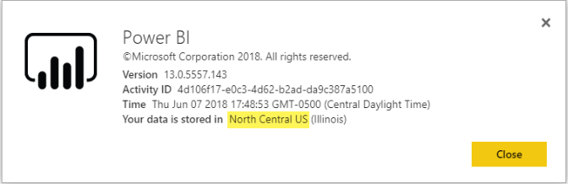
FAQs
Can I only create Power BI Embedded capacities in a specific region?
How can I find what is my PBI tenant region?
With the Multi-geo (Preview) feature, you can purchase a Power BI Embedded capacity in a different region than your Power BI home tenant location
You can use the PBI portal to understand what is your PBI Tenant region.
https://app.powerbi.com/ > ? > About Power BI

Slide 15
FAQs
What is supported by the Cloud Solution Provider (CSP) channel?
Why do I get an unsupported account message?
You can create PBIE for your tenant with subscription type CSP
Partner account can sign in to customer tenant and purchase PBIE for customer tenant, specify customer tenant user as Power BI capacity admin
Power BI requires you to sign up with an organizational account. Trying to sign up for Power BI using an MSA (Microsoft account) isn't supported.

Slide 16
FAQs
Can I use APIs to create & manage Azure capacities?
What is the difference between using RLS vs. JavaScript filters?
Yes, there are Powershell cmdlets and Azure Resource Manager APIs you can use to create & manage PBIE resources.
Rest APIs
https://docs.microsoft.com/rest/api/power-bi-embedded/
Powershell cmdlet
https://docs.microsoft.com/powershell/module/azurerm.powerbiembedded/
There’s often confusion around when to use RLS vs. JavaScript filters, because one method is about controlling what a specific user can see, and the other is about optimizing the user's view.
For RLS, the ISV developer controls the data filtering as part of the model creation and embed token generation. The end user sees only what the ISV allows the user to see. In this case, the user can choose to see less than what's being filtered, but won’t be able to bypass the RLS configuration and see more than what's allowed.
For client-side filtering (JavaScript), the ISV might decide what the end user sees at the initial view, but the ISV cannot control changes the end user might apply to the view itself. Even though data filtering can happen on the backend, it’s triggered by the JavaScript client code, and therefore it can be changed by an end user, and cannot be considered secure.
Reference RLS vs JavaScript filters for more details.

Slide 17
FAQs
When to use an application ID vs. a service principal object ID?
Can you manage an On-premises data gateway with service principal?
The application ID is used to create the access token when passing the application ID for authentication.
To reference a service principal for operations or to make changes you use the service principal object ID — for example, applying a service principal as an admin to a workspace.
You can't manage an On-premises data gateway (data gateway) using service principal like you can with a master account.
With a master account, you can install a data gateway, add users to the gateway, connect to data sources, and do other administrative tasks.
With service principal, you can configure row-level security (RLS) using an SQL Server Analysis Services (SSAS) on-premises live connection data source. This way you can manage users and their access to data in SSAS when integrating with Power BI Embeddedusing a service principal.

Slide 18
FAQs
What are the Azure regions PBI Embedded is available?
Can you sign into the Power BI service with service principal?
PAM (EcoManager) - see Product availability manager
Available regions (16 - same regions as Power BI)
US (6) - East US, East US 2, North Central US, South Central US, West US, West US 2
Europe (2) - North Europe, West Europe
Asia Pacific (2) - Southeast Asia, East Asia
Brazil (1) - Brazil South
Japan (1) - Japan East
Australia (1) - Australia Southeast
India (1) - West India
Canada (1) - Canada Central
United Kingdom (1) - UK South
No - you can't sign into Power BI using service principal.
Also, you can’t consume content as a user in external applications (SaaS embed), only when you generate an embed token.

Slide 19
FAQs
My Application already uses AAD for User Authentication. How can we use this Identity when authenticating to Power BI in a "User Owns Data" scenario?
It is standard OAuth on-behalf-of flow (https://docs.microsoft.com/azure/active-directory/develop/active-directory-authentication-scenarios#web-application-to-web-api)
The Application needs to be configured to require permissions to Power BI service (with the required scopes), and once you have a user token to your app, you simply call to ADAL API AcquireTokenAsync using the user access token and specify Power BI resource URL as the resource ID,
See a code snippet showing how this can be done…
var context = new AD.AuthenticationContext(authorityUrl);
var userAssertion = new AD.UserAssertion(userAccessToken);
var clientAssertion = new AD.ClientAssertionCertificate(MyAppId, MyAppCertificate)
var authenticationResult = await context.AcquireTokenAsync(resourceId, clientAssertion, userAssertion);

Slide 20
Wrap Up

